Slide 1


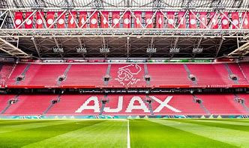

THE NET PRESENT VALUE METHOD
FOOTBALL CLUBS OR PRODUCERS OF MUSIC TALENTS/SHOWS
Today football clubs or producers of talents/shows create value, create superstars in the academies and in collaboration with mass media, like radio and TV, which influence public opinion.
Stars sold
to other clubs
Superstars sold
to other clubs
Today
Invest in young
talents
(Academies)
in 1 year
in 2 years

